Slide 1
Summarising and
showing data fairly
How do we describe thousands of records in one sentence and one chart without misleading anyone?
AI and Data Science Professional | Session 3 of 24 | Module A: Think with data
KLAi Professional Learning | Jotham Martin Wambi
Notes:
Welcome back. Last session we learned what one record of a table stands for and how tables link. Today we describe thousands of records with a few numbers and one chart. You will meet a finding that surprises almost everyone: in the Lakeside workbook the mean order is twice the typical order.
We will learn why, how to choose the right summary, and how a chart can mislead. Everything is done in Google Sheets, with no code.

Slide 2



Today in one view: what you will leave with
By the end of today you can
Choose between the mean, median and mode, and say why, using quartiles, the IQR and the standard deviation
Read a histogram, a box plot and a line chart, and describe a distribution by its skewness
Build a pivot table (a GROUP BY) in Google Sheets, choose a chart for a question, and spot a misleading axis
Notes:
Here is what you can do by the end of today. You can choose between the mean, the median and the mode, and say why, using quartiles, the interquartile range and the standard deviation. You can read a histogram, a box plot and a line chart, and describe the shape of data by its skewness.
And you can build a pivot table in Google Sheets, which is a GROUP BY, choose the right chart for a question, and spot a misleading axis. All of it is on the Lakeside Mart workbook, with no code.

Slide 3

Your two hours: concepts
first, then a Google Sheets lab
Ideas with pictures first. Then you open the sheet. Then the checks and what you keep.
Notes:
We have two hours. The first ten minutes bring back Session 2 and set the question for today. Then forty-five minutes of concepts, with no laptops open, so you can watch the pictures. After a ten minute break we open the Lakeside Mart workbook in Google Sheets for a forty-five minute lab.
You will predict each answer, compute it with a formula, and build a pivot table and charts. The last ten minutes are an exit check and what you keep. The lab is where the learning sticks, so please protect that time.

Slide 4

Three questions from last time
1. Order O000003 has 2 products. How many records does it make in orders, and how many in order_lines?
2. Which variable is the primary key of products, and which tab holds it as a foreign key?
3. customer_id is blank on 580 orders. What do you do first?
Answer aloud first. Then we check together.
Notes:
Three quick questions from Session 2. Answer aloud first, and then we check together. It is a warm-up to bring last time back.
Question one. Order O000003 has 2 products. How many records does it make in orders, and how many in order_lines?
A good answer is this. One record in orders and 2 in order_lines. The two tabs have different granularity.
Question two. Which variable is the primary key of products, and which tab holds it as a foreign key?
A good answer is this. product_id. The order_lines tab holds product_id as a foreign key.
Question three. customer_id is blank on 580 orders. What do you do first?
A good answer is this. Read the data dictionary: the blank means a walk-in. Keep the records and add a flag, instead of deleting or filling them.
If you missed one, check your notes from last session tonight. Now to today.

Slide 5



Answers to the three questions from Session 2
Question | Short answer
Order O000003 has 2 products. How many records does it make in orders, and how many in order_lines? | One record in orders and 2 in order_lines. The two tabs have different granularity.
Which variable is the primary key of products, and which tab holds it as a foreign key? | product_id. The order_lines tab holds product_id as a foreign key.
customer_id is blank on 580 orders. What do you do first? | Read the data dictionary: the blank means a walk-in. Keep the records and add a flag, instead of deleting or filling them.
Notes:
Here are the answers to the three warm-up questions. An order with two products makes one record in orders and two in order lines, because the two tabs have different granularity. The primary key of products is product id, and the order lines tab holds it as a foreign key.
And a blank customer id on 580 orders means a walk-in shopper, so you read the data dictionary first and keep the records. Today every number we compute counts or adds those records. Which of the three did you find hardest?

Slide 6



Words we use today
Word | What it means
Mean, median and mode | Three ways to say what is typical. The mean is the sum divided by the count. The median is the middle value. The mode is the most common value.
Quartiles and IQR | Quartiles cut sorted values into four equal groups. The interquartile range (IQR) is Q3 minus Q1: the spread of the middle half.
Standard deviation | A typical distance from the mean: the square root of the average squared distance (n minus 1 for a sample).
Skewness | How lopsided a distribution is. Right-skewed means a long tail of large values on the right.
Pivot table (GROUP BY) | A table that groups records and summarises each group with an aggregation such as SUM, COUNT or AVERAGE (MEDIAN in Sheets and pandas). In SQL and pandas it is GROUP BY.
Notes:
Five words for today. I give the plain meaning of each, and we use every one of them before the end of the session.
Mean, median and mode. Three ways to say what is typical. The mean is the sum divided by the count. The median is the middle value. The mode is the most common value.
Quartiles and IQR. Quartiles cut sorted values into four equal groups. The interquartile range (IQR) is Q3 minus Q1: the spread of the middle half.
Standard deviation. A typical distance from the mean: the square root of the average squared distance (n minus 1 for a sample).
Skewness. How lopsided a distribution is. Right-skewed means a long tail of large values on the right.
Pivot table (GROUP BY). A table that groups records and summarises each group with an aggregation such as SUM, COUNT or AVERAGE (MEDIAN in Sheets and pandas). In SQL and pandas it is GROUP BY.

Slide 7







Seven summary jobs on order_value_ugx,
each one formula in Sheets
Statistic | Sheets formula | Result
Count | =COUNT(orders!G2:G2001) | 2,000
Sum | =SUM(orders!G2:G2001) | 99,861,360
Mean | =AVERAGE(orders!G2:G2001) | 49,930.68
Median | =MEDIAN(orders!G2:G2001) | 24,800
Mode | =MODE(orders!G2:G2001) | 7,000 (80 orders)
Minimum | =MIN(orders!G2:G2001) | 1,140
Maximum | =MAX(orders!G2:G2001) | 1,935,520
All amounts are in UGX. Column G of the orders tab holds order_value_ugx.
Notes:
Open the workbook. Column G of the orders tab holds the value of each order in shillings. Seven formulas summarise it. Count gives 2,000 orders. Sum gives 99,861,360 shillings. The mean is the sum divided by the count, 49,931. The median is the middle value after sorting, 24,800.
The mode is the most common value, 7,000 shillings, which appears 80 times. The smallest order is 1,140 and the largest is 1,935,520. Notice that the mean is about double the median. That gap is today's main story. Why do you think it happens?

Slide 8


The workbook is a sample of the full file,
so its figures are close but not identical
Workbook: 2,000 orders
Full file: 30,229 orders
Mean 49,931 UGX
Median 24,800 UGX
Mean is 2.01 times the median
Mean 47,491 UGX
Median 23,200 UGX
Mean is 2.05 times the median
The story is the same. Session 4 explains why the figures differ.
Notes:
The workbook has only 2,000 orders. It is a sample, a slice drawn from the full Lakeside Mart file of 30,229 orders. On the left are the workbook figures: mean 49,931 shillings and median 24,800. On the right are the full file figures: mean 47,491 and median 23,200.
So your answers in Sheets are close to the full file and never match it exactly. In both, the mean is more than double the median. The finding is the same either way. Session 4 is all about why a sample differs from the whole. Which figure would you quote to your manager?

Slide 9
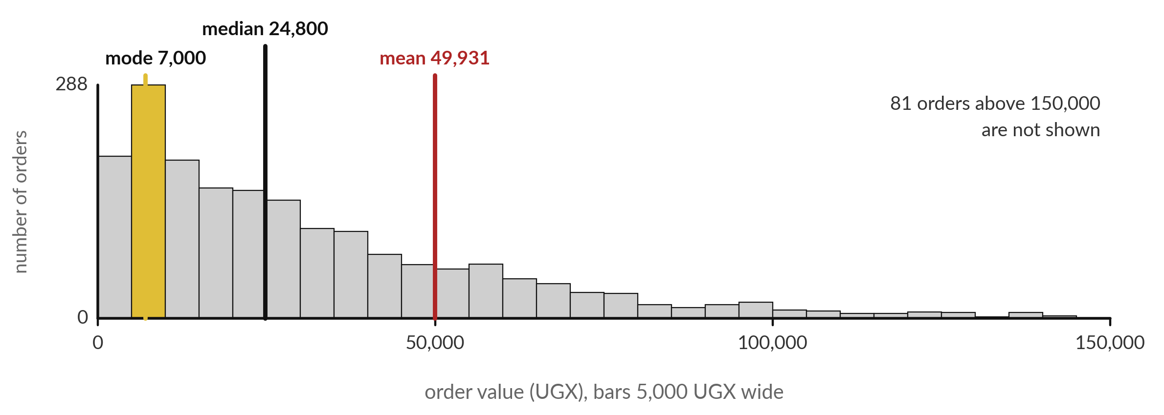
A histogram shows the distribution, and a few
large orders pull the mean above the median
Each bar counts the orders in a band. The gold bar holds the mode. The largest order is off the edge.
Notes:
This is a histogram. It is a chart that counts how many records fall into each band of equal width. Each bar here is a band of 5,000 shillings of order value, and its height is the number of orders in it. Start on the left. Most orders are small, and the tallest bar, in gold, is the mode band.
Then follow the bars to the right. They get shorter, and a long thin tail runs out of the picture. The black line is the median, 24,800. The red line is the mean, 49,931. The few large orders drag the mean to the right. A manager asks what a typical order is worth.
Which line do you give?

Slide 10

The mean is the sum of the values
divided by how many there are
Symbol | What it means | In our data
x-bar | The mean (arithmetic mean) | 49,930.68 UGX
n | The number of records | 2,000
x_i | The value of record i | order_value_ugx of one order
Σ (sigma) | Add up the values from i = 1 to n | Sum = 99,861,360
In Sheets: =AVERAGE(orders!G2:G2001). The median is the middle value after sorting.
Notes:
Here is the mean as a formula. X-bar is the mean. Add up all n values, which the sigma sign means, and divide by n. In our data the sum of order values is 99,861,360 and n is 2,000, so the mean is 49,930.68 shillings. In Sheets that is the function AVERAGE.
You have done this all your working life. What is new is the median. The median is the middle value after sorting, so it depends on position and not on how large the largest values are. Which of the two do you think a few huge orders move?

Slide 11


One huge order moves the
mean but not the median
Mean
Median
All orders: 49,931 UGX
Without the largest: 48,987 UGX
It moved by about 943 UGX (49,930.68 to 48,987.41)
All orders: 24,800 UGX
Without the largest: 24,800 UGX
It did not move at all
For money amounts, give the median beside the mean, and say how many records you counted.
Notes:
Take away the largest order in the workbook, 1,935,520 shillings at Jinja. The mean drops from 49,931 to 48,987, a move of 943 shillings. The median stays at 24,800. The median ignores how large the large values are. It only cares about their position in the sorted line.
A statistic that barely moves when one extreme value changes is called resistant, or robust. So here is the trap. If you report that a typical order is about 50,000 shillings, the formula is right but the sentence misleads, because half of all orders are under 24,800. Which would you lead with?

Slide 12
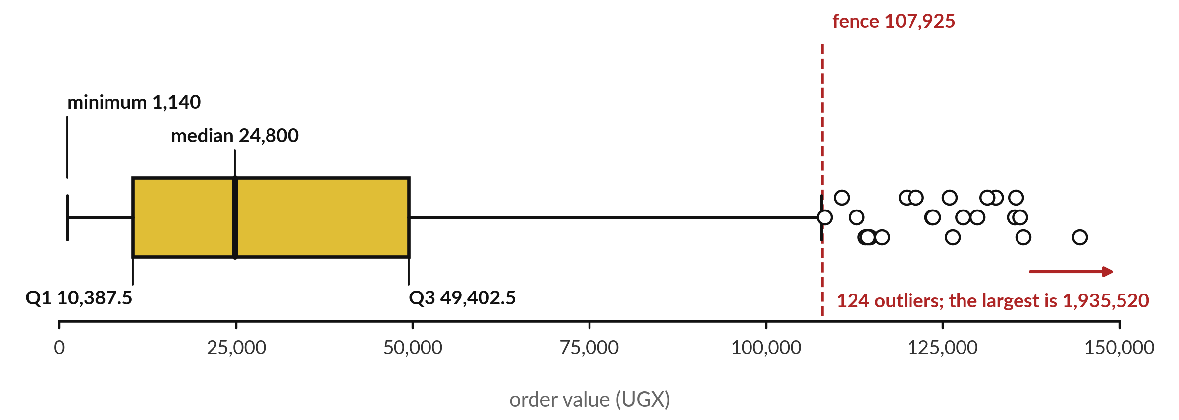
A box plot shows the quartiles: the
box holds the middle half of the orders
IQR = Q3 minus Q1 = 39,015 UGX. Beyond Q3 + 1.5 × IQR, the dots are outliers by the IQR rule.
Notes:
A box plot draws the quartiles. Quartiles are three cut points that split the sorted orders into four equal groups. The first quartile, Q1, is 10,387.5. The median, which is the second quartile, is 24,800. The third quartile, Q3, is 49,402.5. The gold box runs from Q1 to Q3, so it holds the middle half of the orders.
Its length is the interquartile range, the IQR: Q3 minus Q1, which is 39,015. The IQR rule calls a value an outlier when it lies beyond Q3 plus one and a half times the IQR, here 107,925. 124 orders, 6.2 percent, lie beyond it. Why might a retail shop have such orders?

Slide 13






The five-number summary and the
outlier fence, each one formula in Sheets
What you want | Sheets formula | Result
Minimum | =MIN(orders!G2:G2001) | 1,140
First quartile, Q1 | =QUARTILE(orders!G2:G2001,1) | 10,387.5
Median, Q2 | =MEDIAN(orders!G2:G2001) | 24,800
Third quartile, Q3 | =QUARTILE(orders!G2:G2001,3) | 49,402.5
Maximum | =MAX(orders!G2:G2001) | 1,935,520
IQR | Q3 minus Q1 | 39,015
Orders beyond the fence | =COUNTIF(orders!G2:G2001,">107925") | 124
The fence is Q3 + 1.5 × IQR = 49,402.5 + 1.5 × 39,015.0 = 107,925.0. The fence is exactly 107,925, so the formula uses 107925. A percentile such as the 90th is =PERCENTILE(range,0.9).
Notes:
Here are the formulas. QUARTILE of the range with a one gives Q1, and with a three gives Q3. The IQR is the difference. The fence is Q3 plus one and a half times the IQR, which is 107,925.0. COUNTIF with greater than 107925 counts the orders beyond it: 124.
Sheets QUARTILE equals QUARTILE.INC and the pandas default, which interpolate between values, so the two agree here. QUARTILE.EXC and some textbooks use other rules and give slightly different quartiles. A percentile such as the ninetieth is PERCENTILE of the range with 0.9. What would you do with the orders beyond the fence?

Slide 14

The standard deviation is a typical
distance of the values from the mean
Symbol | What it means | In our data
s | The sample standard deviation: root of the average squared distance, n − 1 for a sample. Its square is the variance. | 128,094 UGX
x_i − x-bar | How far record i sits from the mean (a deviation) | One order minus 49,930.68
(…)² | Square each deviation, so negatives do not cancel | Units are UGX squared
n − 1 | The count minus one (ddof=1 in pandas) | 1,999
In Sheets: =STDEV(orders!G2:G2001). For a whole population, =STDEV.P divides by n instead.
Notes:
Here is the standard deviation. For each record, find its deviation, which is its distance from the mean. Square each deviation so that negatives do not cancel the positives. Add the squares, divide by n minus one, and take the square root to get back to shillings. The result, s, is the sample standard deviation, and its square is the variance.
For the order values, s is about 128,094 shillings. That is larger than the mean itself, which tells you the values are very spread out. In Sheets the function is STDEV. Why do you think we take a square root at the end?

Slide 15

One example by hand: the
standard deviation of five orders
Order value x (UGX) | Deviation x − mean | Squared deviation
66,200 | 24,634 | 606,833,956
3,100 | -38,466 | 1,479,633,156
52,200 | 10,634 | 113,081,956
79,830 | 38,264 | 1,464,133,696
6,500 | -35,066 | 1,229,624,356
Mean 41,566 | Sum 0 | Sum 4,893,307,120
Variance = 4,893,307,120 ÷ 4 = 1,223,326,780. Standard deviation = square root = 34,976 UGX. These are the first five orders in the orders tab.
Notes:
Let us do it by hand on five orders, the first five in the orders tab. Their mean is 41,566. Subtract the mean from each value to get the deviations. They add up to zero, which is why we square them. The squares add up to 4,893,307,120. Divide by n minus one, which is four, to get the variance, 1,223,326,780.
The square root is the standard deviation, 34,976 shillings. Check it in Sheets: STDEV of G2 to G6 gives the same. Compare that with the standard deviation of all 2,000 orders, 128,094. Why is it so much larger for the whole file?

Slide 16

One large order moves the standard
deviation by 7,115 UGX and the IQR by 10
Measure | All 2,000 orders | Without the largest order
Mean | 49,931 | 48,987
Median | 24,800 | 24,800
Standard deviation | 128,094 | 120,979
IQR | 39,015 | 39,005
All amounts are in UGX. The mean and the standard deviation react to extreme values. The median and the IQR resist them.
Notes:
Here is the same comparison for the spread. With the largest order removed, the standard deviation falls from 128,094 to 120,979, a drop of 7,115. The IQR moves from 39,015 to 39,005, a change of only 10. The mean and the standard deviation both use every value, so extreme values pull on them.
The median and the IQR use positions in the sorted list, so they resist. A common pair to report is the mean with the standard deviation when data is roughly symmetric, and the median with the IQR when it is skewed. Which pair fits order values?

Slide 17
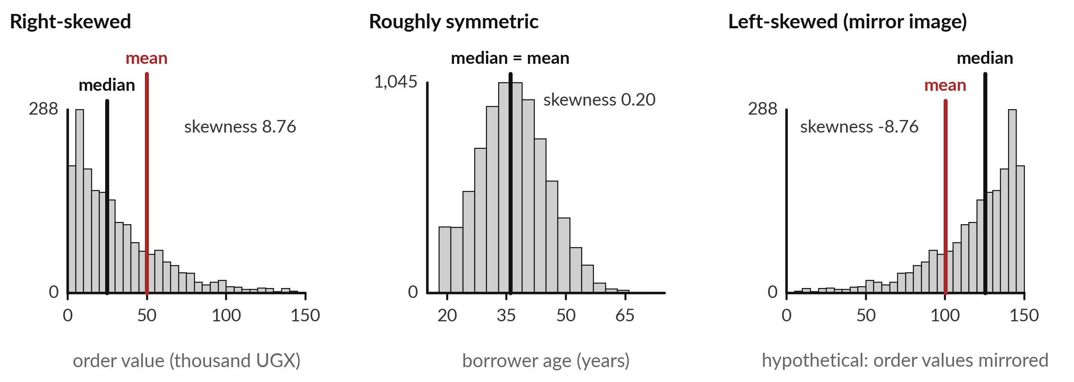
Skewness describes the shape: a long
tail on one side pulls the mean towards it
Left: order values. Middle: ages of 7,998 borrowers. Right: the left picture reversed (hypothetical).
Notes:
Skewness describes the shape of a distribution. The left picture is right-skewed: a long tail of large values on the right, and the mean, in red, sits to the right of the median. The skewness number for order values is 8.76, a large positive number. The middle picture shows ages of 7,998 borrowers in the fictional Nile Microfinance file, after removing 2 impossible ages.
It is roughly symmetric, a bell shape, with the mean and median together and a skewness near zero. The right picture is the first one reversed. It is hypothetical, and it shows a left-skewed shape, with the mean to the left of the median. Which shape do you expect for incomes in your district?

Slide 18
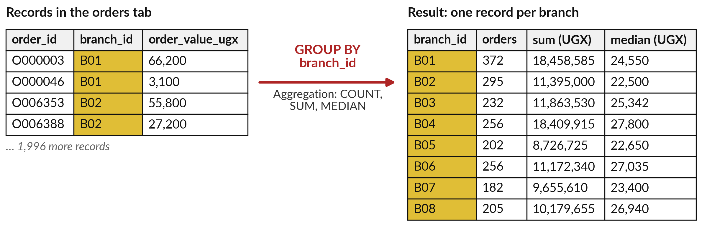
A pivot table is a GROUP BY: it groups
the records and summarises each group
Each group is one branch. An aggregation turns many records into one number.
Notes:
A pivot table groups records and summarises each group. On the left are four records from the orders tab, each with a branch id. The arrow says group by branch id. On the right is the result: one record for each of the eight branches. For each group we computed an aggregation, which is an aggregate function such as COUNT, SUM or MEDIAN.
Branch B01 has 372 orders with a median of 24,550. In SQL and pandas the same step is called GROUP BY and groupby, so learning the pivot table now teaches you both. What other grouping would help your manager, by month or by payment method?

Slide 19



The same GROUP BY question in three tools
Tool | How you write it | What it returns
Google Sheets | Insert, Pivot table. Rows: branch_id. Values: SUM of order_value_ugx | One row for each branch
SQL | SELECT branch_id, SUM(order_value_ugx) FROM orders GROUP BY branch_id | The same, from a database
pandas | orders.groupby('branch_id').order_value_ugx.sum() | The same, in Python
The result is the same in every tool. We meet SQL in Session 10 and pandas groupby in Session 9.
Notes:
Here is the same question in three tools. In Sheets you insert a pivot table, put branch id in the rows, and sum order value. In SQL you write SELECT, the branch, the sum of the value, FROM orders, GROUP BY branch. In pandas you call groupby on the branch column and then sum.
The result is one row per branch in all three. Once you can read a pivot table, the SQL and the pandas are just different spellings of it. We meet SQL in Session 10 and pandas groupby in Session 9. Which of these three would your employer expect you to know?

Slide 20

Jinja leads on the mean and the median, but
the medians of all eight branches are close
Branch | Orders | Mean (UGX) | Median (UGX)
B01 Kampala Central | 372 | 49,620 | 24,550
B02 Kampala Ntinda | 295 | 38,627 | 22,500
B03 Entebbe | 232 | 51,136 | 25,342
B04 Jinja | 256 | 71,914 | 27,800
B05 Mbale | 202 | 43,202 | 22,650
B06 Mbarara | 256 | 43,642 | 27,035
B07 Fort Portal | 182 | 53,053 | 23,400
B08 Gulu | 205 | 49,657 | 26,940
Medians run from 22,500 to 27,800 UGX. Without its largest order (1,935,520 UGX), Jinja's mean falls from 71,914 to 64,605 and Jinja still leads.
Notes:
This is the pivot result with the mean and the median for each branch. Jinja has the highest mean order, 71,914 shillings. One order of 1,935,520 adds about 7,300 to it, and Jinja still leads without it. The medians tell a calmer story. They run from 22,500 at Kampala Ntinda to 27,800 at Jinja.
So the typical order is similar everywhere. A group summary needs the count and a resistant measure beside the mean. Would you have spotted this from the totals alone?

Slide 21
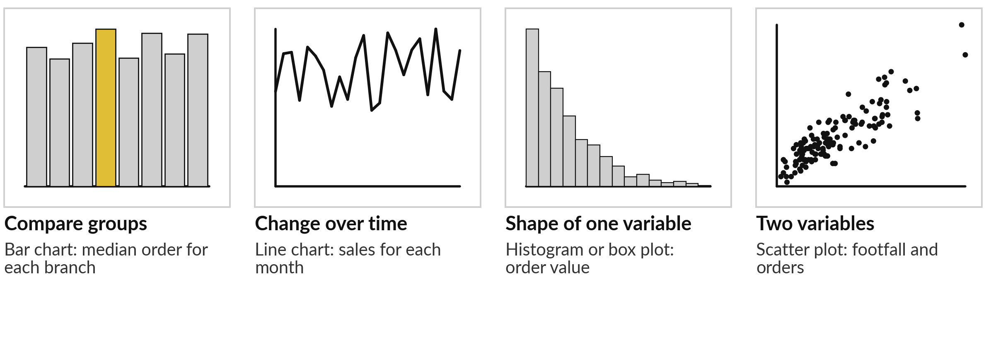
Choose the chart from the
question you are asking
Real Lakeside data in every panel. Avoid pie charts: people compare angles badly.
Notes:
Pick the chart from the question. To compare groups, use a bar chart: here the median order for each branch. To show change over time, use a line chart: sales for each month. To show the shape of one variable, use a histogram or a box plot: the order values.
To show how two variables go together, use a scatter plot: weekly footfall against weekly orders for the branches. I suggest you avoid pie charts, because people compare angles and areas badly, and a bar chart always does the job better. Every panel here is drawn from the real workbook.
Which question do you ask most at work?

Slide 22
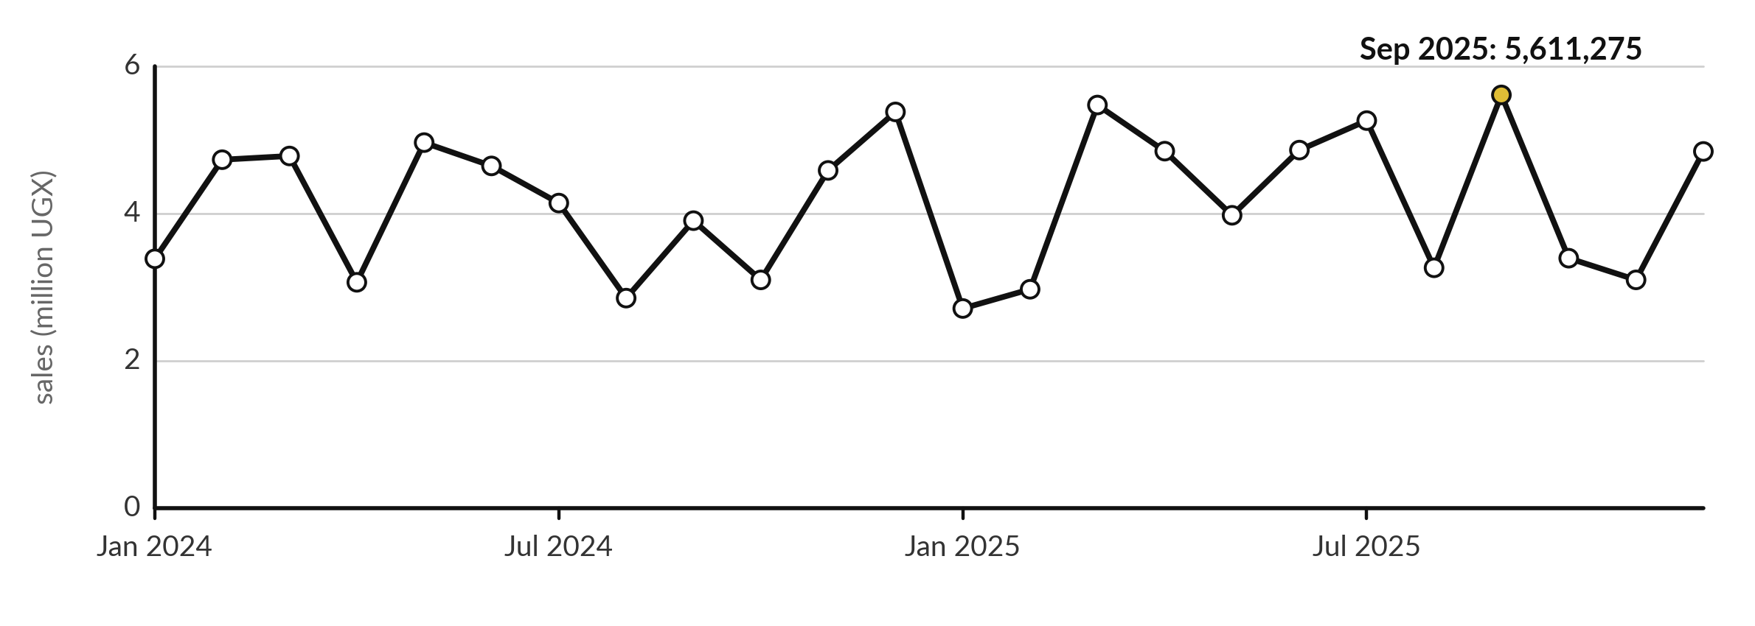
A line chart shows change over time; start its axis
at zero unless you say clearly that you did not
Monthly total of order_value_ugx. About 83 orders a month, so a few large orders can move a month.
Notes:
A line chart joins a value for each period, so the eye can follow the change. This one shows the monthly total of order values, January 2024 to December 2025. Its vertical axis starts at zero. The highest month is Sep 2025, at 5,611,275 shillings. The lowest is Jan 2025, at 2,711,425.
December 2024 is only number 3 of 24, at 5,380,425, so it does not stand out the way it does in the full file. The reason is that the sample has about 83 orders a month, so a few large orders can reorder the months. What would you want to know before telling anyone that December is the peak?

Slide 23
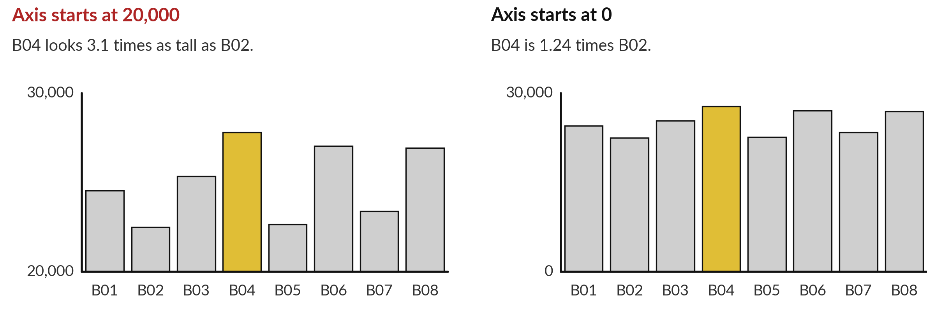
A truncated axis makes a 24
percent gap look 3.1 times taller
The same eight branch medians of order value in UGX. A bar chart must start at zero.
Notes:
Here are the same eight branch medians on two charts. On the left the vertical axis starts at 20,000. B04, in gold, rises 7,800 above the base and B02 only 2,500, so B04 looks 3.1 times as tall. On the right the axis starts at zero. Now B04 is 1.24 times B02, about 24 percent more.
A bar encodes its value in its length, so cutting the base changes the message. A line chart can sometimes zoom in fairly, but a bar chart should start at zero. Which of the two would your manager remember?

Slide 24






Six checks before you show a chart
Does the title state the point?
Do the axes have labels and units, such as UGX?
Does a bar chart start at zero?
Is the chart type right for the question?
Does it say how many records it shows, and the source?
Would it still look fair to someone who disagrees with you?
Notes:
Here is a short checklist to run before any chart leaves your desk. Does the title state the point?
Do the axes have labels and units, such as UGX?
Does a bar chart start at zero?
Is the chart type right for the question?
Does it say how many records it shows, and where they came from?
And the last one is the hardest: would the chart still look fair to someone who disagrees with you?
A chart that passes all six is hard to attack and easy to trust. Which of the six do you most often forget?

Slide 25




Where you will use this at work: report the
typical value and the spread beside the total
Your job | The question | What today lets you do
Branch manager at a retail chain, using Excel or Sheets | What does a typical customer spend? | Report the median order with the IQR and the number of orders.
Credit analyst at a bank, using SQL | How large is a typical loan in each district? | Write a GROUP BY with COUNT and AVG for each district, and take the median in pandas.
Health records officer at a district office, using pandas | Monthly visits for 12 districts | Report the median visits and the IQR for each district before you rank districts.
Programme officer at an NGO, handing over to Power BI | Which region gained most? | Pick a chart from the question, and start bar charts at zero.
Notes:
Where will you use this on Monday?
Four examples. A branch manager at a retail chain asks what a typical customer spends, and reports the median order with the IQR and the number of orders. A credit analyst at a bank writes a GROUP BY with COUNT and AVG for each district, and takes the median in pandas.
A health records officer reports the median visits and the IQR for each district before ranking the districts. And a programme officer at an NGO, handing over to Power BI, picks a chart from the question and starts bar charts at zero. Which of these is closest to your job?

Slide 26
Read the recipe before the lab:
five formulas summarise a variable
In plain words
=MEDIAN(orders!G2:G2001)
=QUARTILE(orders!G2:G2001,3)
=STDEV(orders!G2:G2001)
=COUNTIF(orders!G2:G2001,">107925")
=LEFT(orders!B2,7)
Line 1 gives the median: 24,800.
Line 2 gives Q3: 49,402.5.
Line 3 gives the sample standard deviation: about 128,094.
Line 4 counts the outliers beyond the fence: 124.
Line 5 takes the first 7 characters of the text date, such as 2024-01. It makes a month column for the pivot table.
Notes:
Before the lab, read the five formulas that do most of the work. Line one, MEDIAN of the order values, gives 24,800. Line two, QUARTILE with a three, gives Q3, 49,402.5. Line three, STDEV, gives about 128,094. Line four, COUNTIF with greater than 107925, counts the orders beyond the fence, 124.
Line five uses LEFT to take the first seven characters of the date. The dates in this workbook are stored as text, so LEFT gives us a month such as 2024 dash 01, which the pivot table can group by. Which formula would you change to find the median of the order lines instead?

Slide 27
Part 2: the Sheets lab
Close the slides. Open the sheet.
Notes:
That is the end of the ideas. Everything you need is on the slides you have just seen, and the lab sheet repeats each step. Open the Lakeside Mart workbook in Google Sheets, or in Excel if you prefer. Today you add a month column, build three pivot tables, and make three charts.
In every task, predict the answer first, then compute it with a formula or a pivot table, then write what you found.

Slide 28
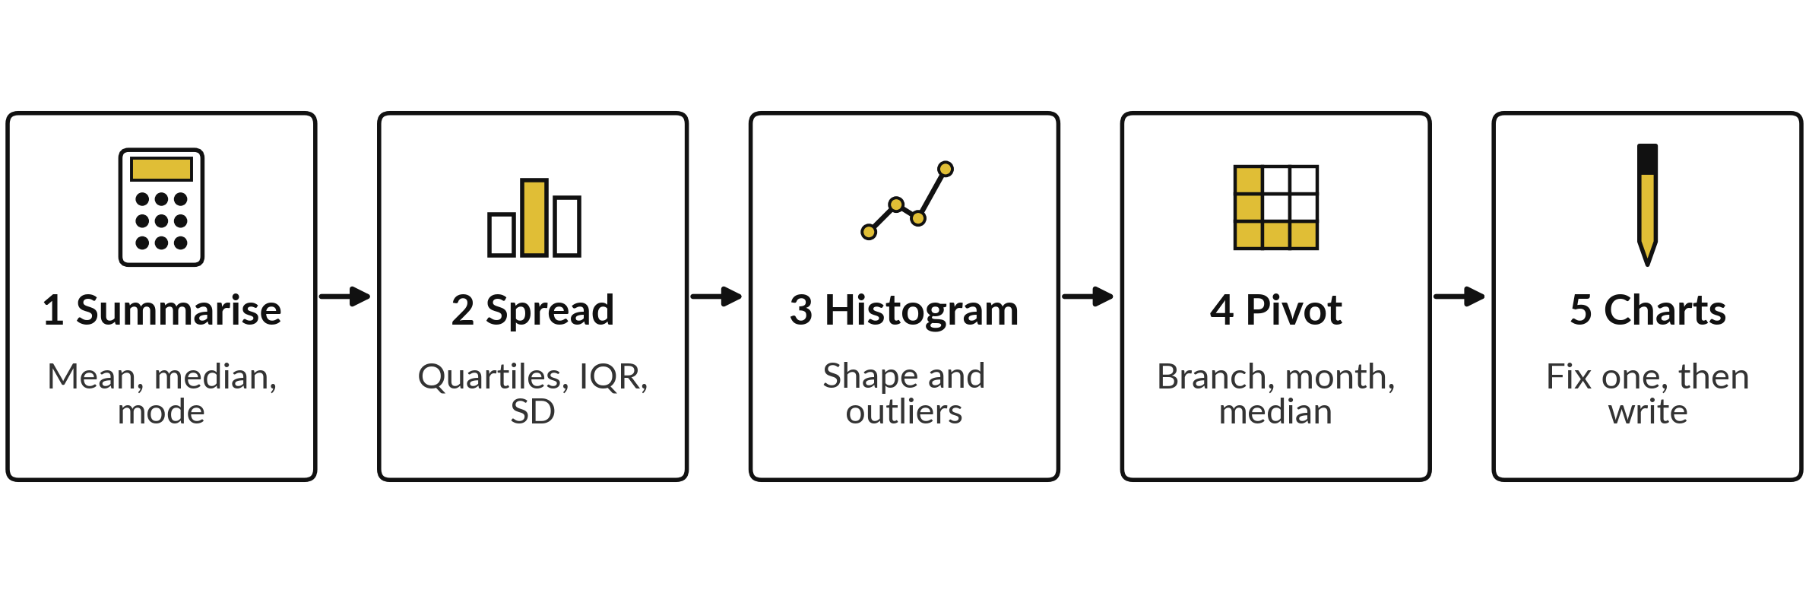
The lab has five steps, and you keep
a workbook with pivots and charts
Eight tasks in 45 minutes. For each task, predict the answer, compute it, then write it in a notes tab.
Notes:
Here is the map of the lab. Step one, summarise the order values with the mean, median and mode. Step two, find the quartiles, the IQR, the fence and the standard deviation. Step three, draw a histogram and check its bars with COUNTIFS. Step four, add a month column and build the pivot tables: branch by month, and the median by branch.
Step five, make a line chart, fix a misleading bar chart, and write two sentences for a manager. In every task, predict first. Please do not skip the predictions.

Slide 29







Check your numbers before you move on
What you compute | You should get
Mean, median and mode of order_value_ugx | 49,930.68, 24,800 and 7,000
Q1, Q3 and the IQR | 10,387.5, 49,402.5 and 39,015
Sample standard deviation, and orders beyond 107,925 | 128,094 and 124
Orders at most 10,000, at most 50,000 and above 100,000 | 491, 1,512 and 139
Orders in December 2024 | 116
Pivot grand total, and December 2024 total | 99,861,360 and 5,380,425
Highest and lowest branch median | 27,800 (B04) and 22,500 (B02)
Highest and lowest month | Sep 2025 and Jan 2025
If your number differs, find the task that went wrong. Do not change a number to match.
Notes:
Use this table as your own self-check. Nobody marks it. If your numbers match, carry on. If one does not, stop and call me, because later tasks use the earlier ones. The most common causes are a range that includes the header row, a month column that was not filled all the way down, and a pivot table whose values are counted instead of summed.
Do not change a number to make it match. Find out why it is different. What does it mean if your grand total is far too small?

Slide 30

Five likely mistakes in the lab and how to fix them
What you see | What it means | What to do
A pivot table shows Count where you wanted Sum | The summarise setting is COUNTA. | In the pivot editor, set Summarize by to SUM or MEDIAN.
#NAME? or a blank month column | The equals sign is missing, or the column is not filled down. | Type =LEFT(B2,7) and drag the fill handle to row 2001.
A histogram with one tall bar | The huge orders stretch the axis. | Customize: outlier percentile 95, bucket size 10000.
A column chart whose axis starts at 20,000 | The axis minimum is set above zero. | Customize, Vertical axis, set Min to 0.
A bar differs by a few orders from the answer | Tools treat a bucket edge differently. | Accept a difference of up to 3 orders.
Notes:
Five problems you may meet. A pivot table that shows Count where you wanted Sum: open the pivot editor and change Summarize by. A blank month column: type the LEFT formula with the equals sign and fill it down. A histogram with one tall bar: the huge orders stretch the axis, so set the outlier percentile to ninety-five and the bucket size to ten thousand.
A column chart that starts at twenty thousand: set the vertical axis minimum to zero. And a bar that differs by a few orders from the answer is normal, because tools treat bucket edges differently. Read the message first. It usually tells you the answer.

Slide 31


Exit check: three questions, then
compare with the short answers
Question | Short answer
A manager asks what a typical order is worth. Which statistic do you lead with, and what else do you give? | The median, 24,800 UGX, with the number of orders and the IQR. The mean, 49,931, is pulled up by a few large orders.
What is a pivot table in SQL and in pandas? | A GROUP BY in SQL and groupby in pandas: group the records, then aggregate each group.
A bar chart makes a small gap between two branches look huge. What do you check first? | Whether the vertical axis starts at zero. Cutting the base makes small gaps look large.
Notes:
Last, the exit check. Three questions. Write your answers in your notes before you look at mine. One, a manager asks what a typical order is worth. Which statistic do you lead with, and what do you give beside it?
Two, what is a pivot table called in SQL and in pandas?
Three, a bar chart makes a small gap look huge. What do you check first?
The short answers are on the slide. If you got all three, you are ready for Session 4. These are also the warm-up questions at the start of that session.

Slide 32
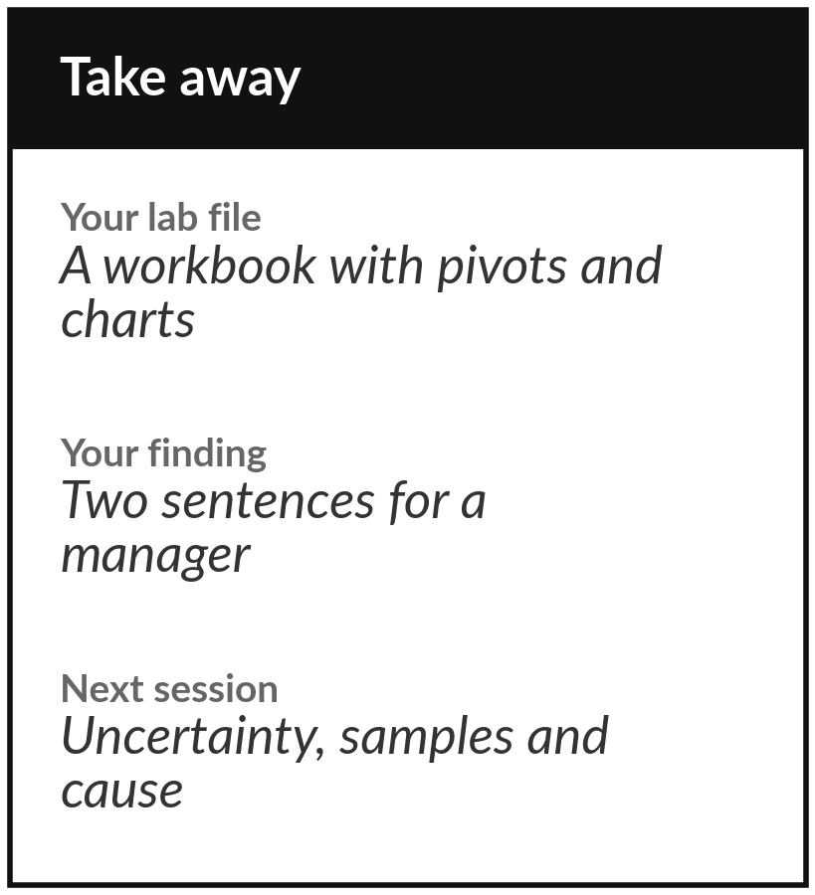
Save your workbook with
its pivot tables and charts
What you keep from today
Keep your workbook with three pivot tables, three charts you could show a manager, and two sentences that describe the typical order and the branches.
Our question today
How do we describe thousands of records in one sentence and one chart without misleading anyone?
Next session
Session 4: Uncertainty, samples and cause. We ask how far a sample can sit from the truth, and when a pattern means that one thing caused another.
Notes:
Before you go, save your workbook with the three pivot tables and the charts. Those are your keepsake from today, together with two sentences you could hand to a manager: one on the typical order and one on whether the branches differ. Check that each chart has a title, labelled axes with units, and a bar axis that starts at zero.
Next session we ask a harder question about numbers like these: how much can they move just because of which records we looked at?
If anything was unclear today, write the question down and bring it.
We began with this question: How do we describe thousands of records in one sentence and one chart without misleading anyone? Before you go, say in one sentence what you can now say about it.

